Slide 1
Modified Distribution Method

Slide 2
Modified Distribution Method
The Modified Distribution Method, also known as MODI method or u-v method, which provides a minimum cost solution (optimal solution) to the transportation problem. The following are the steps involved in this method.
Step 1: Find out the basic feasible solution of the transportation problem using any one of the three methods discussed in the previous section.
Step 2: Introduce dual variables corresponding to the row constraints and the column constraints. If there are m origins and n destinations then there will be m+n dual variables. The dual variables corresponding to the row constraints are represented by ui, i=1,2,…..m where as the dual variables corresponding to the column constraints are represented by vj, j=1,2,…..n. The values of the dual variables are calculated from the equation given below
ui + vj = cij if xij > 0

Slide 3
Step 3: Any basic feasible solution has m + n -1 xij > 0. Thus, there will be m + n -1 equation to determine m + n dual variables. One of the dual variables can be chosen arbitrarily. It is also to be noted that as the primal constraints are equations, the dual variables are unrestricted in sign.
Step 4: If xij=0, the dual variables calculated in Step 3 are compared with the cij values of this allocation as cij – ui – vj. If all cij – ui – vj ≥ 0, then by the theorem of complementary slackness it can be shown that the corresponding solution of the transportation problem is optimum. If one or more cij – ui – vj < 0, we select the cell with the least value of cij – ui – vj and allocate as much as possible subject to the row and column constraints. The allocations of the number of adjacent cell are adjusted so that a basic variable becomes non-basic.
Step 5: A fresh set of dual variables are calculated and repeat the
entire procedure from Step 1 to Step 5.

Slide 4
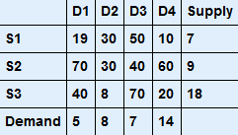
Example-1 Find Solution using Vogel's Approximation method, also find optimal solution using MODI method,
Ref: https://cbom.atozmath.com/example/CBOM/Transportation.aspx?he=e&q=modi

Slide 5
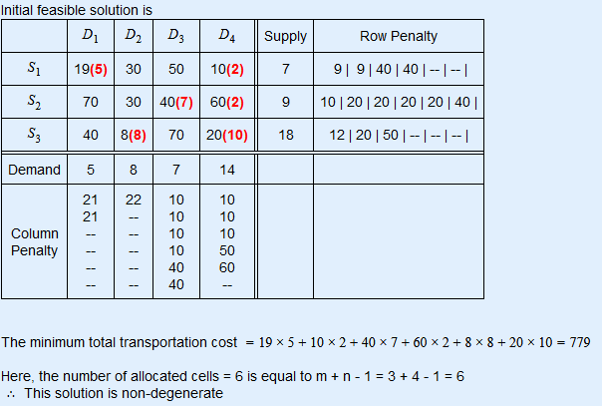
Solution:

Slide 6
Non - degenerate basic feasible solution: A basic feasible solution to a (m x n) transportation problem is said to be non – degenerate if,
the total number of non-negative allocations is exactly m + n – 1 (i.e., number of independent constraint equations), and
these m + n – 1 allocations are in independent positions.
Degenerate basic feasible solution: A basic feasible solution in which the total number of non-negative allocations is less than m + n – 1 is called degenerate basic feasible solution.
http://ecoursesonline.iasri.res.in/mod/page/view.php?id=2959#:~:text=Non%20%2Ddegenerate%20basic%20feasible%20solution,allocations%20are%20in%20independent%20positions.

Slide 7
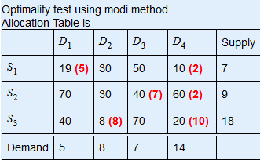
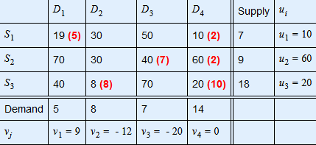
Iteration-1 of optimality test 1. Find ui and vj for all occupied cells(i,j), where cij=ui+vj
Substituting, v4=0, we get 1. c14=u1+v4⇒u1=c14-v4⇒u1=10-0⇒u1=10 2. c11=u1+v1⇒v1=c11-u1⇒v1=19-10⇒v1=9 3. c24=u2+v4⇒u2=c24-v4⇒u2=60-0⇒u2=60 4. c23=u2+v3⇒v3=c23-u2⇒v3=40-60⇒v3=-20 5. c34=u3+v4⇒u3=c34-v4⇒u3=20-0⇒u3=20 6. c32=u3+v2⇒v2=c32-u3⇒v2=8-20⇒v2=-12

Slide 8
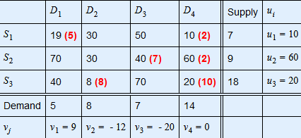
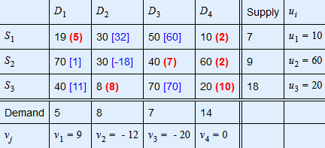
2. Find dij for all unoccupied cells(i,j), where dij=cij-(ui+vj)
1.d12=c12-(u1+v2)=30-(10-12)=32 2.d13=c13-(u1+v3)=50-(10-20)=60 3.d21=c21-(u2+v1)=70-(60+9)=1 4.d22=c22-(u2+v2)=30-(60-12)=-18 5.d31=c31-(u3+v1)=40-(20+9)=11 6.d33=c33-(u3+v3)=70-(20-20)=70

Slide 9
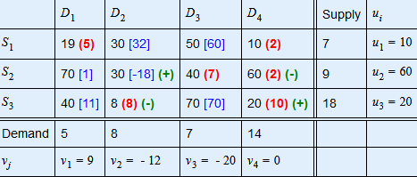
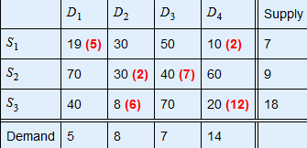
3. Now choose the minimum negative value from all dij (opportunity cost) = d22 = [-18] and draw a closed path from S2D2. Closed path is S2D2→S2D4→S3D4→S3D2 Closed path and plus/minus sign allocation...
4. Minimum allocated value among all negative position (-) on closed path = 2
Substract 2 from all (-) and Add it to all (+)

Slide 10
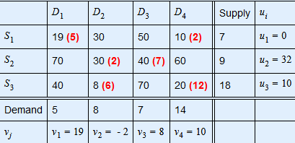
5. Repeat the step 1 to 4, until an optimal solution is obtained.
Iteration-2 of optimality test 1. Find ui and vj for all occupied cells(i,j), where cij=ui+vj
1. Substituting, u1=0, we get 2.c11=u1+v1⇒v1=c11-u1⇒v1=19-0⇒v1=19 3.c14=u1+v4⇒v4=c14-u1⇒v4=10-0⇒v4=10 4.c34=u3+v4⇒u3=c34-v4⇒u3=20-10⇒u3=10 5.c32=u3+v2⇒v2=c32-u3⇒v2=8-10⇒v2=-2 6.c22=u2+v2⇒u2=c22-v2⇒u2=30+2⇒u2=32 7.c23=u2+v3⇒v3=c23-u2⇒v3=40-32⇒v3=8

Slide 11
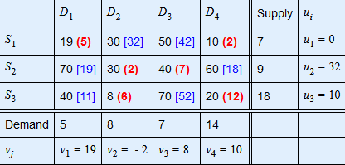
2. Find dij for all unoccupied cells(i,j), where dij=cij-(ui+vj)
1.d12=c12-(u1+v2)=30-(0-2)=32 2.d13=c13-(u1+v3)=50-(0+8)=42 3.d21=c21-(u2+v1)=70-(32+19)=19 4.d24=c24-(u2+v4)=60-(32+10)=18 5.d31=c31-(u3+v1)=40-(10+19)=11 6.d33=c33-(u3+v3)=70-(10+8)=52
Since all dij≥0. So final optimal solution is arrived.

Slide 12
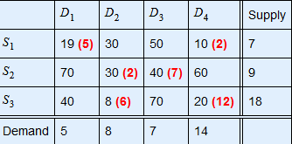
The minimum total transportation cost =19×5+10×2+30×2+40×7+8×6+20×12=743

Slide 13
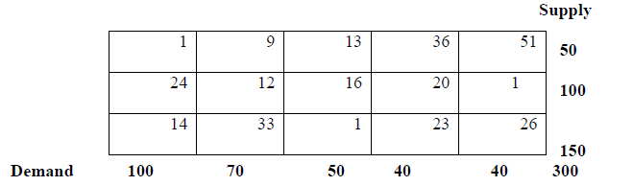
For example consider the transportation problem given below:
Solution:
Step 1: First we have to determine the basic feasible solution. The basic feasible solution using least cost method is

Slide 14



Slide 15
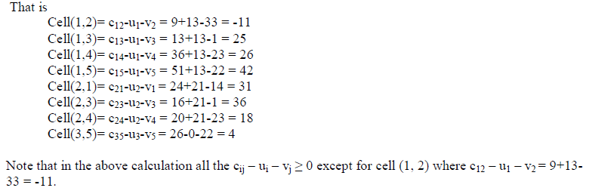

Slide 16
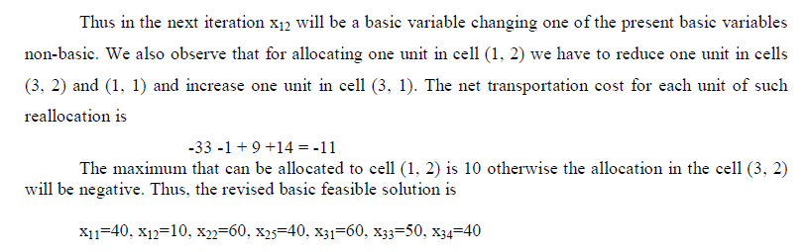

Slide 17
Unbalanced Transportation Problem
In the previous section we discussed about the balanced transportation problem i.e. the total supply (capacity) at the origins is equal to the total demand (requirement) at the destination. In this section we are going to discuss about the unbalanced transportation problems i.e. when the total supply is not equal to the total demand, which are called as unbalanced transportation problem.
In the unbalanced transportation problem if the total supply is more than the total demand then we introduce an additional column which will indicate the surplus supply with transportation cost zero. Similarly, if the total demand is more than the total supply an additional row is introduced in the transportation table which indicates unsatisfied demand with zero transportation cost.

Slide 18

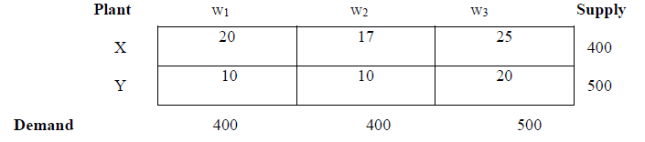
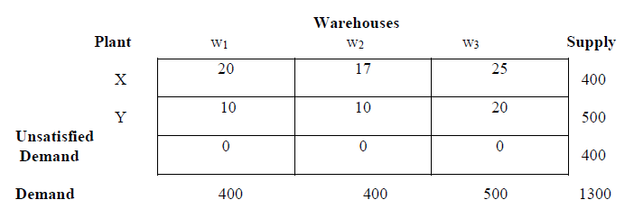
Example
Consider the following unbalanced transportation problem
In this problem the demand is 1300 whereas the total supply is 900. Thus, we now introduce an additional row with zero transportation cost denoting the unsatisfied demand. So that the modified transportation problem table is as follows:
Now we can solve as balanced problem discussed as in the previous sections.

Slide 19
Degenerate Transportation Problem
In a transportation problem, if a basic feasible solution with m origins and n destinations has less than m + n -1 positive Xij i.e. occupied cells, then the problem is said to be a degenerate transportation problem. The degeneracy problem does not cause any serious difficulty, but it can cause computational problem while determining the optimal minimum solution.
Therefore it is important to identify a degenerate problem as early as beginning and take the necessary action to avoid any computational difficulty. The degeneracy can be identified through the following results:
In a transportation problem, a degenerate basic feasible solution exists if and only if some partial sum of supply (row) is equal to a partial sum of demand (column).

Slide 20

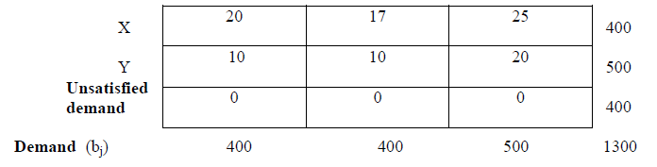
For example, the following transportation problem is degenerate. Because in this problem​
There is a technique called perturbation, which helps to solve the degenerate problems.

Slide 21
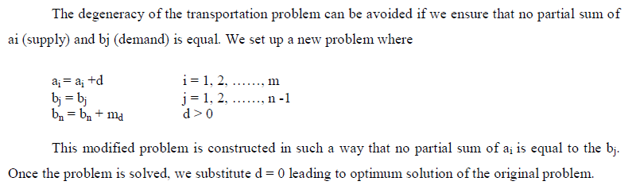
Perturbation Technique:

Slide 22
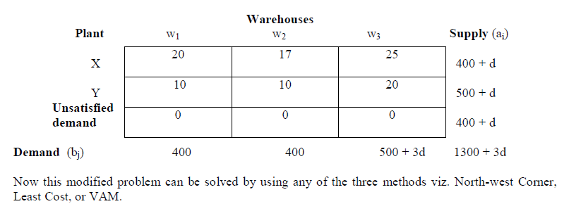
Consider the problem

Slide 23
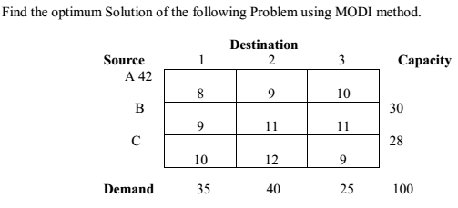

Self Assessment Questions

Slide 24
